Slide 2
IOT Based Smart Agriculture System
Department of Computer Science and Engineering

Slide 3
Supervised by: Prof.Ritika Bhatt
Team Members
1.Aayushi Jain(0827CS201007)
2.Amisha Linjhara(0827CS201029)
3.Ankur Nagar(0827CS201035)
4.Atharva Pagare(0827CS201048)

Slide 4
Introduction
The project aims to develop an IoT system that can monitor soil moisture, temperature, and other environmental factors in real-time.
By monitoring soil moisture, temperature, and other environmental factors, the system will provide accurate and timely information to optimize resource allocation and enhance crop growth.

Slide 5
Limitation of Existing Systems
Agrisense: Limited compatibility and integration with certain types of sensors or agricultural equipment.
GreenField IoT: It has Interoperability Issues, IoT devices have compatibility issues.
SmartAgro: User interface complexity, potentially impacting the ease of use for farmers with varying levels of technical expertise.

Slide 6
Objectives
Develop an IoT-based system that enables real-time monitoring of key agricultural parameters, including soil moisture, temperature, humidity, light intensity, and weather conditions.
Develop interactive and visually appealing graphs, charts to represent the real-time data collected from agricultural parameters.

Slide 7
Requirement Analysis
Functional Requirements
NonFunctional Requirements
Circuit Configuration
Data Transmission to Bolt Cloud
Real-Time Visualization
Sensor Data Acquisition
Scalability
Performance
Interoperability
Reliability

Slide 8
IOT Based Smart Agriculture System
Hardware Setup: Acquiring the BOLT module kit, which includes a microcontroller, sensors, and connectivity options.
Sensor Integration: Connecting and integrating the sensors with the BOLT module using the appropriate interfaces or protocols.
Data Collection and Processing: Configure the BOLT module to collect data from the connected sensors at regular intervals.
Connectivity and Communication: Configure the BOLT module to send the processed data to a centralized server or cloud platform.

Slide 9
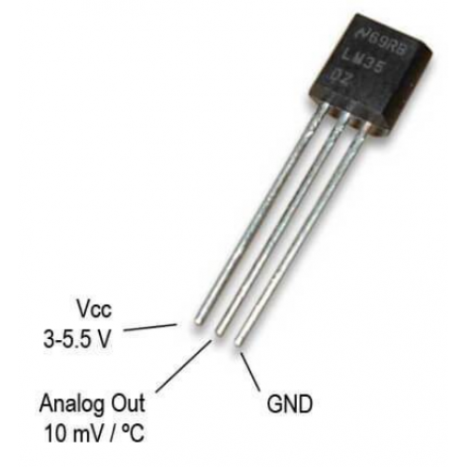
Hardware Components
LM35 Sensor(Temperature sensor)
Temperature sensors measure the ambient temperature in an area.
They are essential for tracking temperature fluctuations that can impact plant growth.

Slide 10
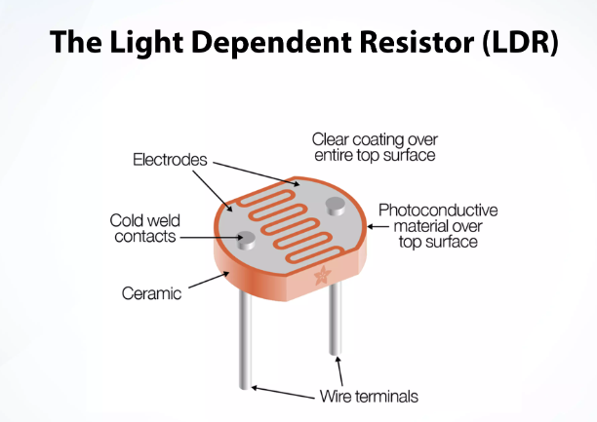
Hardware Components
Light Dependent Resistor(LDR)
They are used to monitor natural light conditions, which is essential for photosynthesis in plants.

Slide 11
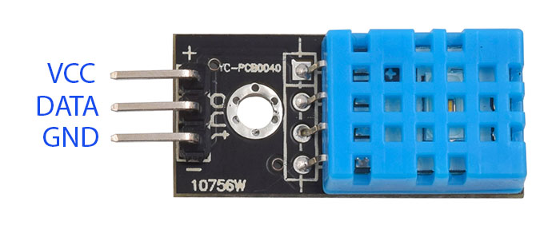
Hardware Components
DHT11 Humidity Sensor
Humidity sensors, also known as hygrometers, measure the amount of moisture in the air.

Slide 12
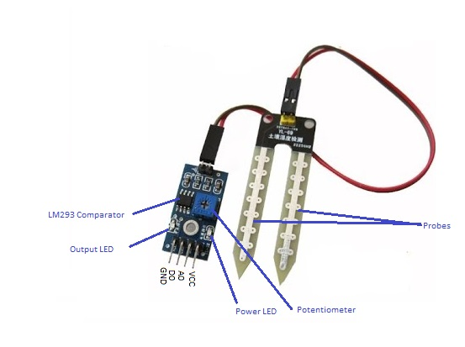
Hardware Components
FC-28 Soil Moisture Sensor
Soil moisture sensors determine the moisture content in the soil, which is crucial for understanding the water needs of the plants.

Slide 13
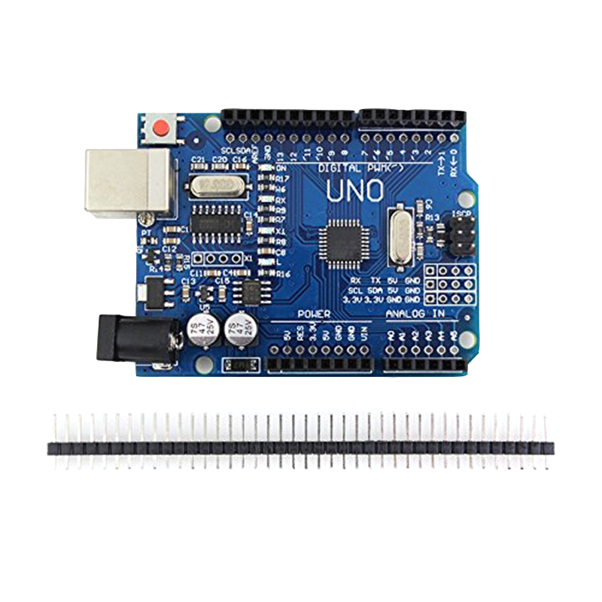
Hardware Components
Arduino UNO
Serves as the project's microcontroller, responsible for processing sensor data and controlling connected devices for automated farming tasks.

Slide 14
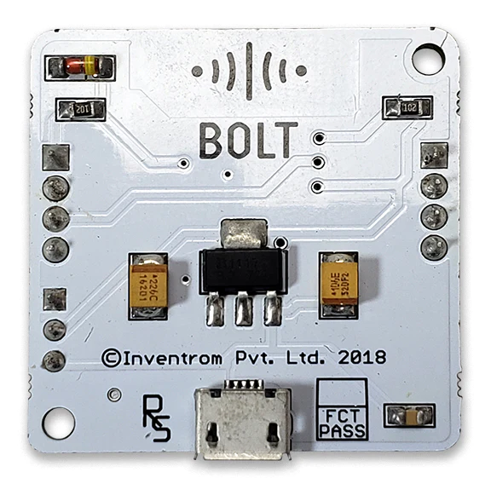
Hardware Components
Bolt ESP8266 Wifi Module
Enables wireless communication between sensors and the cloud, allowing remote monitoring and control of agricultural parameters.

Slide 15
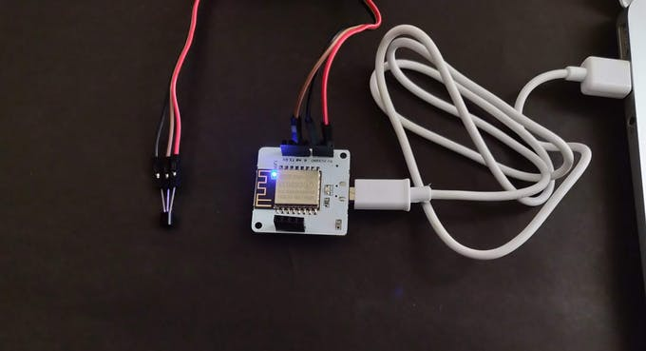
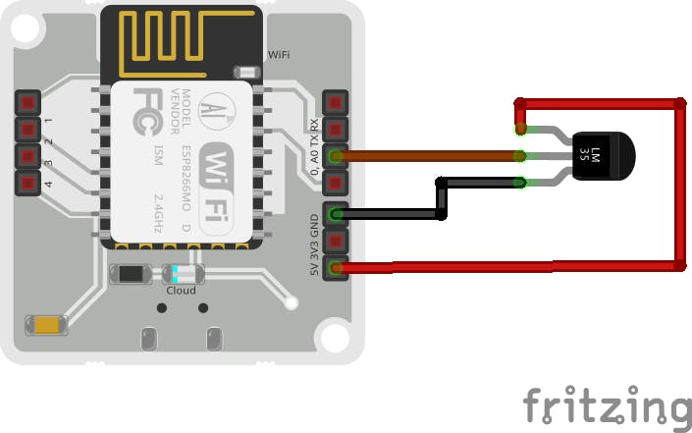
Implementation of LM35

Slide 16
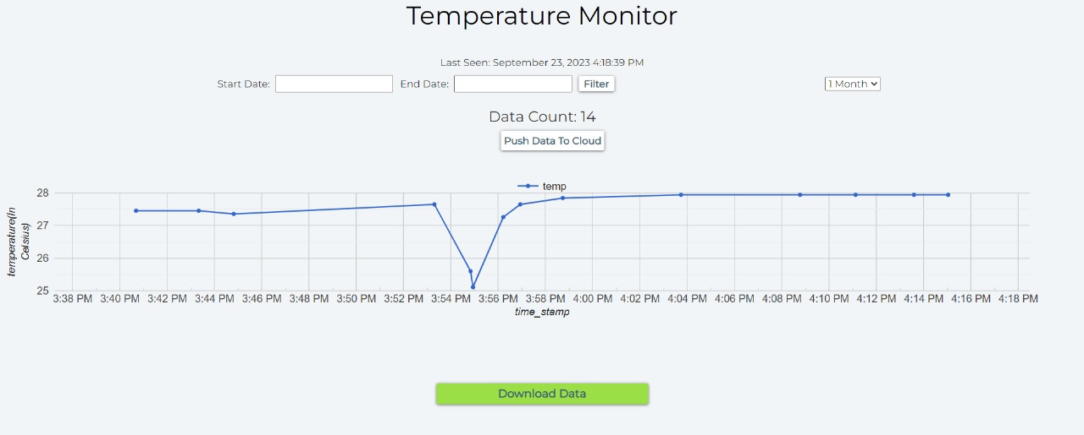
Graph of Temperature Sensor

Slide 17
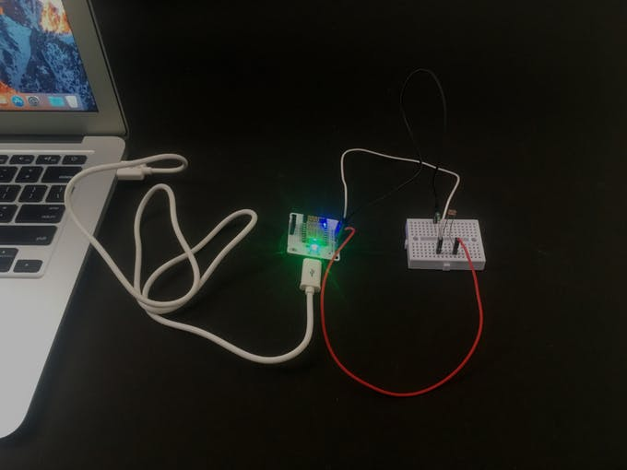
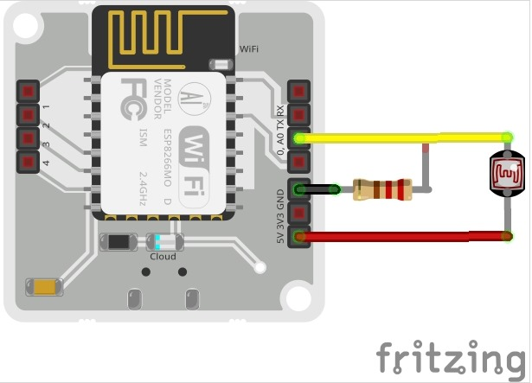
Implementation of LDR

Slide 18
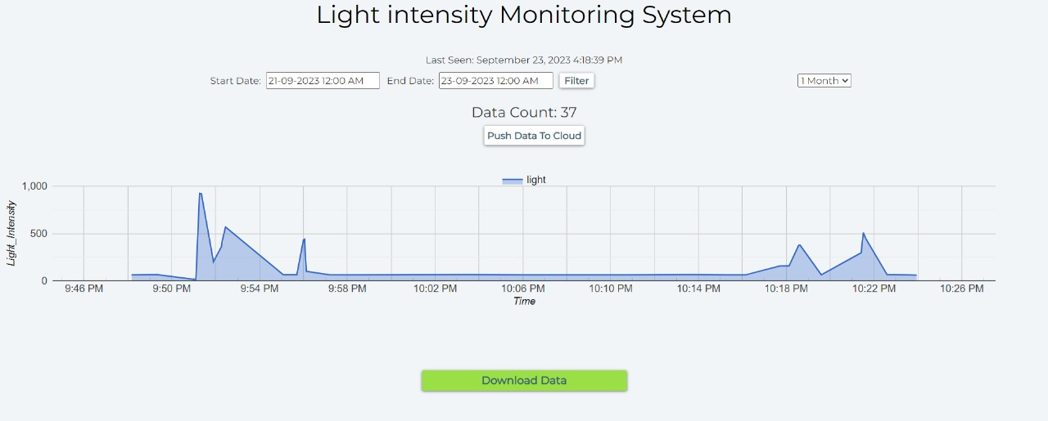
Graph of Light Intensity Sensor

Slide 19
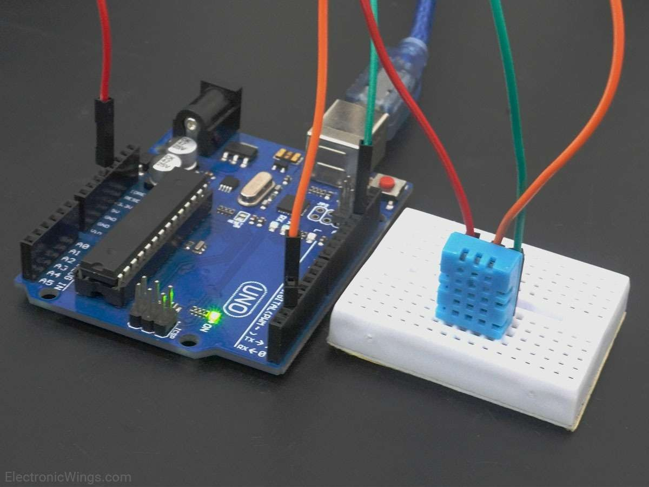
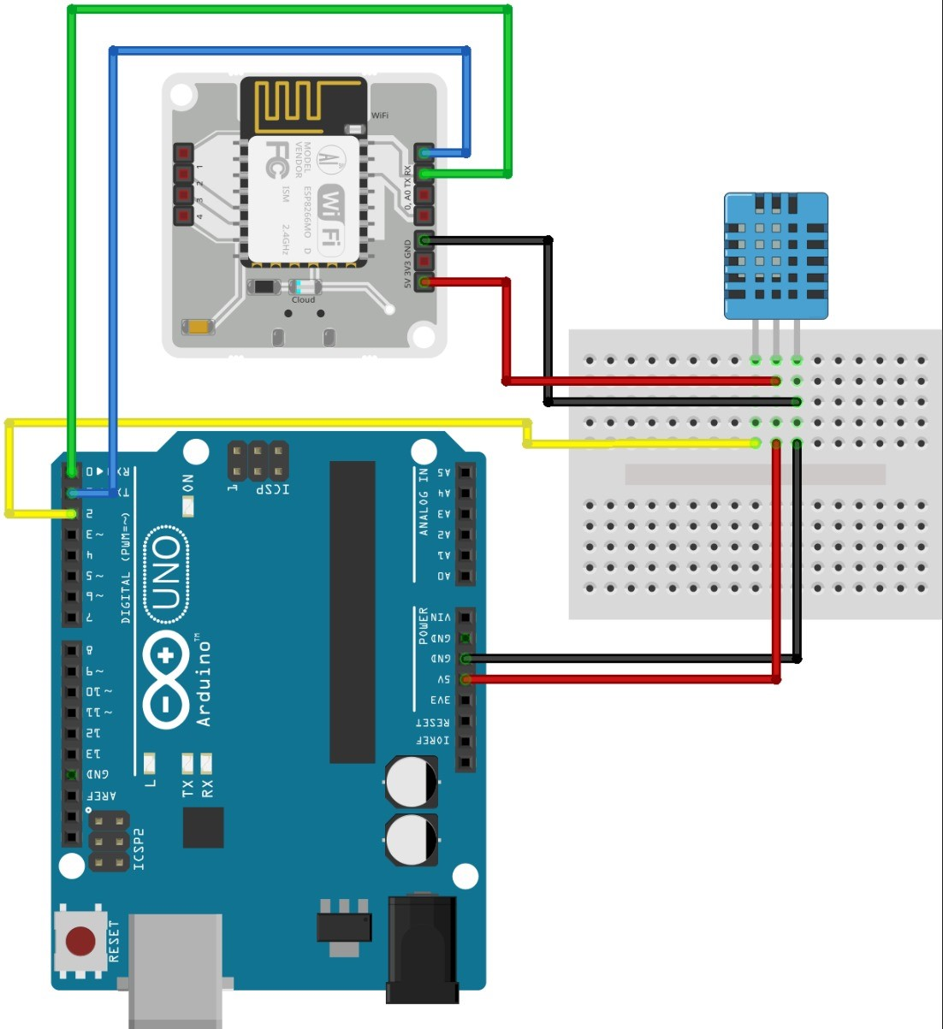
Implementation of DHT11

Slide 20
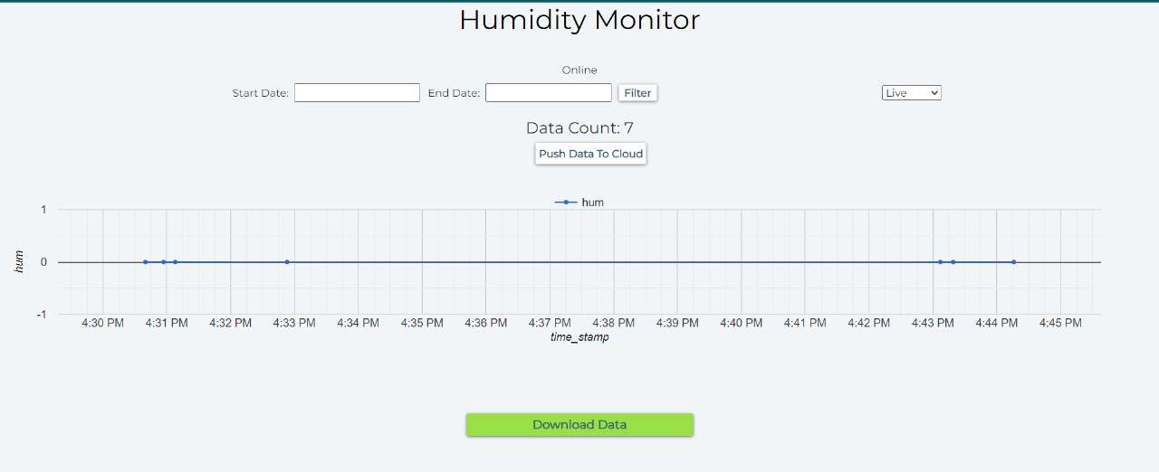
Graph of Humidity Sensor

Slide 21
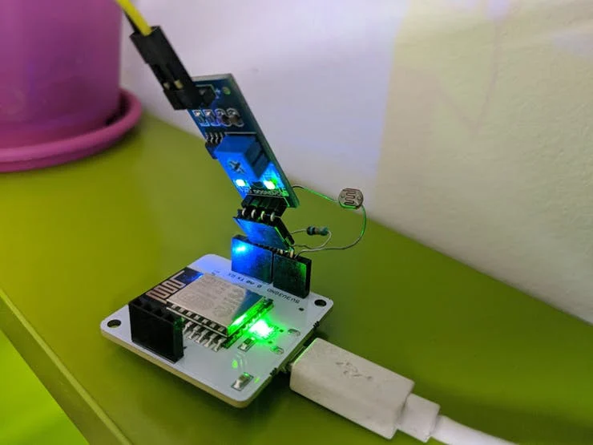
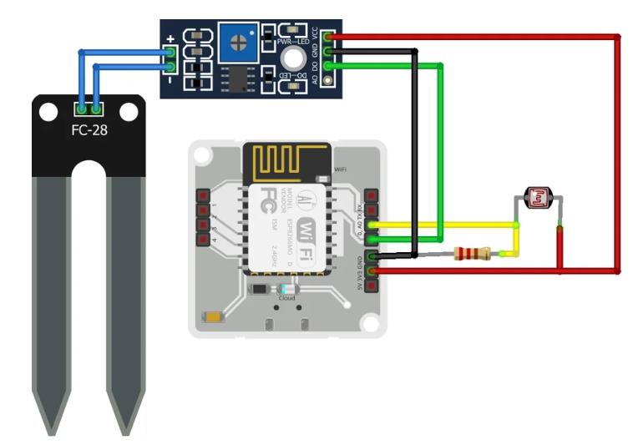
Implementation of FC28

Slide 22
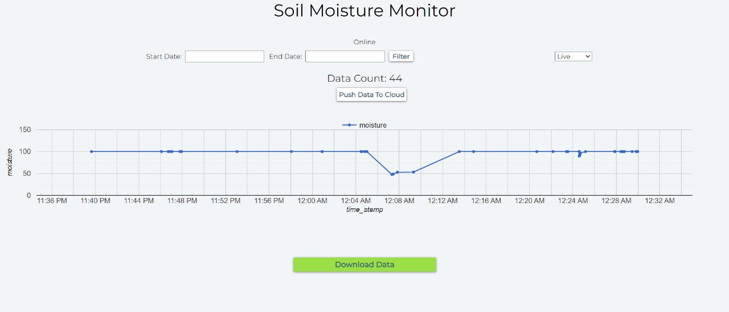
Graph of Soil Moisture Sensor

Slide 23
Conclusion
The Smart Agriculture IoT Project exemplifies the transformation of conventional farming methods through IoT technologies.
It enables real-time monitoring, evaluation, and control of various aspects of agricultural systems.
Integration of hardware and software resources leads to increased output, resource optimization, and environmentally friendly farming practices.

Slide 24
THANKS

